Slide 1

Reimbursement Services
Rahul Kumar Yadav 20104093
Mansi Viramgama 20104115
Mayank Viramgama 20104119
Project Guide
Prof.Yaminee Patil

Slide 2
Contents
Introduction
Objectives
Scope
Literature Survey
Proposed System
Project Outcomes
Block Diagram
Use Case/DFD
Technology Stack
Suggestions in Review-1
Result and Discussion
Conclusion and Future Scope
References

Slide 3
1. Introduction
Problem Identified :
Difficulty keeping records of expenses spent on courses provided by the college.
Managing records of certifications completed by individual students for particular courses becomes hectic.
Solution Proposed :
A Web Application that will maintain records of past reimbursement and compensation.

Slide 4
2. Objectives
To determine which course student or teacher can claim.
To Create a system for collecting student’s expense claims.
To provide efficiency in managing records of reimbursement.
To maintain a record of past reimbursement/compensation.
To provide a proper visualization and graphical representation of monthly, yearly, and department-wise reimbursement reports.

Slide 5
3. Scope
Can be applied to any organization that wants to keep a record of their reimbursement.
Can be helpful for organizations to get visual analyses of records by filtering the year-wise, department-wise, etc.
Can be applied to any organization that wants to make the reimbursement process easy to apply and keep track of their applied reimbursement, etc.

Slide 6
4. Literature Survey
Survey 1
In market there are very few template or any complete web base application which provide all the needs of any organisations. But there was a drawback that only admin have the access to it. Admin have to feed every single entry into it.
Link: https://github.com/darylnauman/expense-reimbursement-system.git
https://github.com/rupeshg98/EmployeeReimbursementSystem.git
Survey 2
While searching for any other application that serves our needs, we came across another application written in Java. The problem was application was running on legacy code, which hard works with it or makes some improvements in it.
Link: https://github.com/jckuhl/Employee-Reimbursement-System.git

Slide 7
5. Proposed System
Write all the features & Functionality you are planning to implement
Overview of Past Records :
User can get information on past reimbursement at any time.
Add Certificates:
Teachers can maintain certificates of courses completed by students.
Add reimbursement :
Admin can make a new reimbursement entry.

Slide 8
6.Projects Outcomes
The admin will be directed to the dashboard where he can add teachers, add reimbursement, view certificates, and reimbursement requests.
If the user is a teacher he will be able to access Make reimbursement and can manage to wait / approve reimbursement requests.

Slide 9
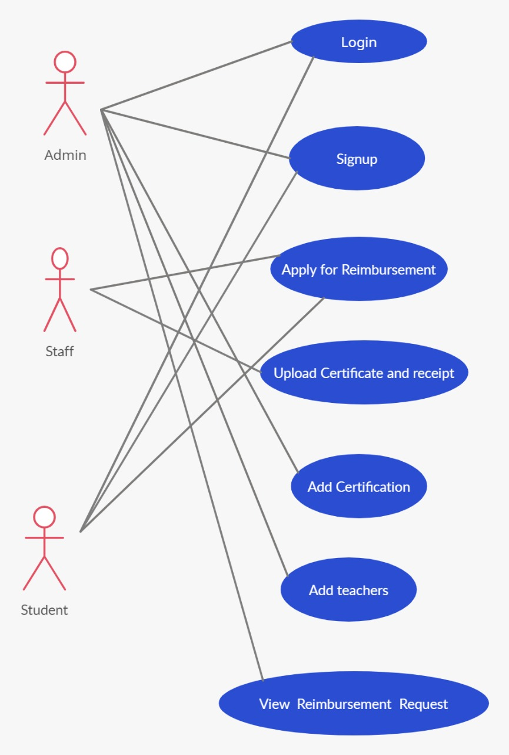
7. Used case Diagram ( if applicable)

Slide 10
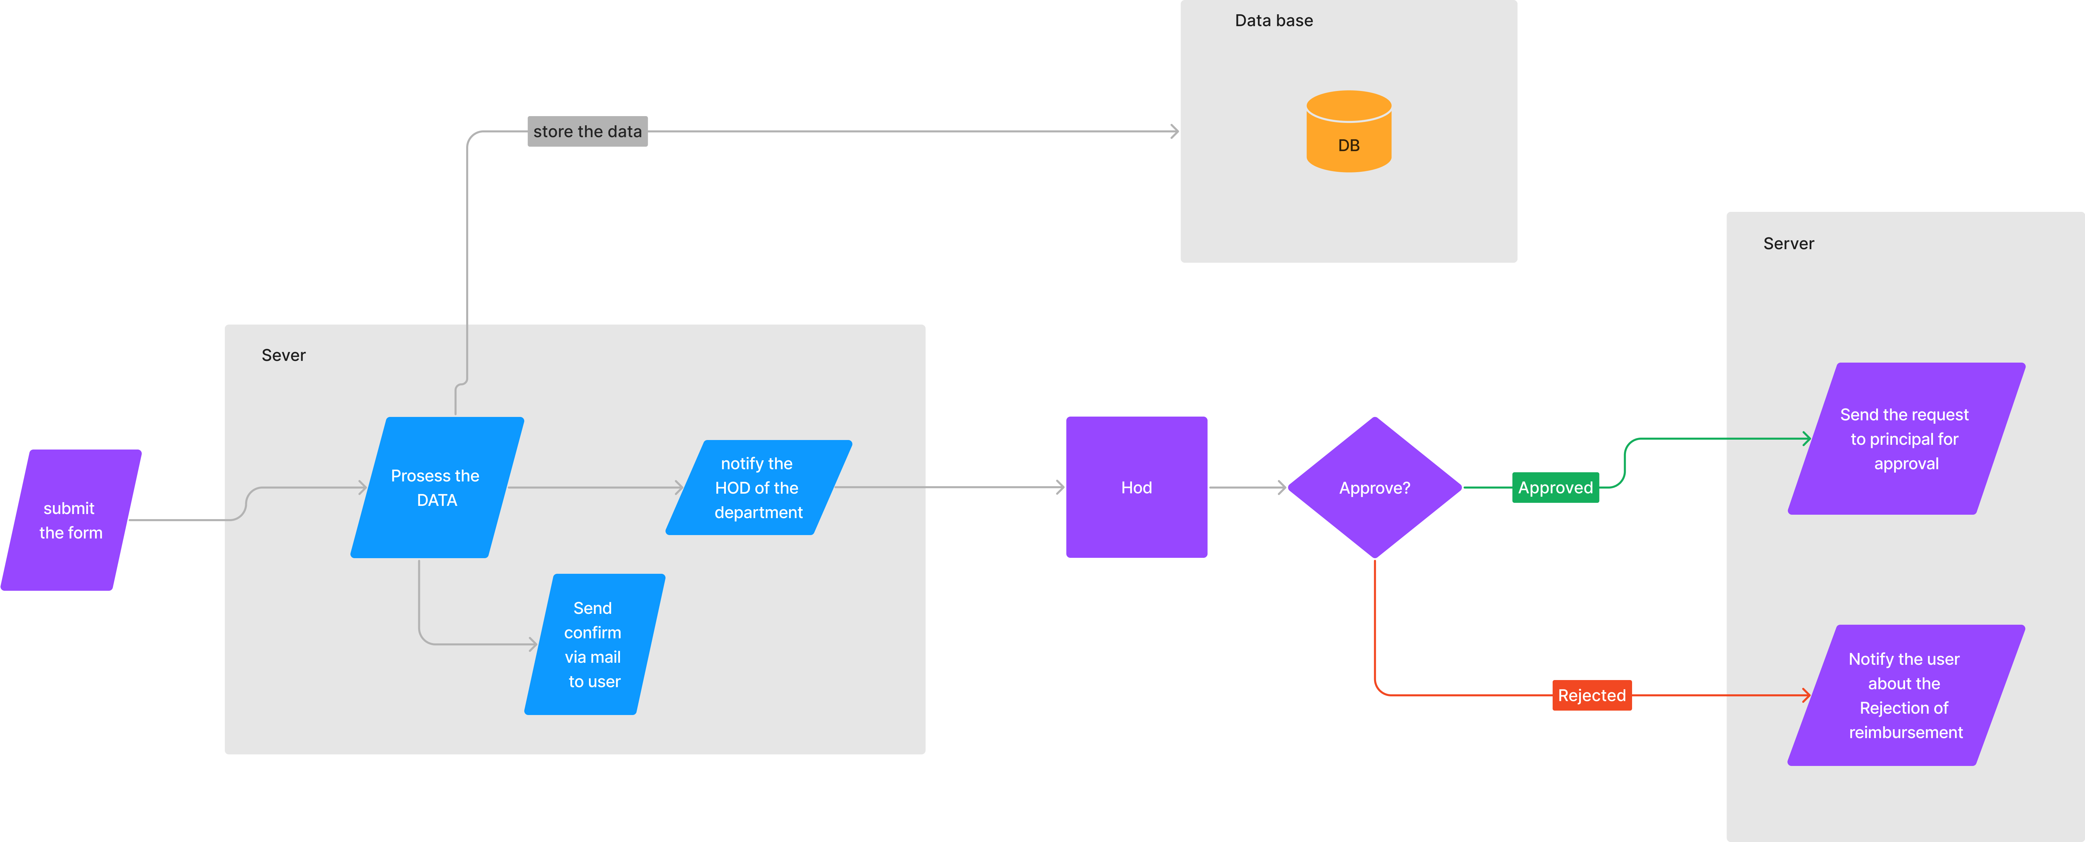
8. Block Diagram

Slide 11
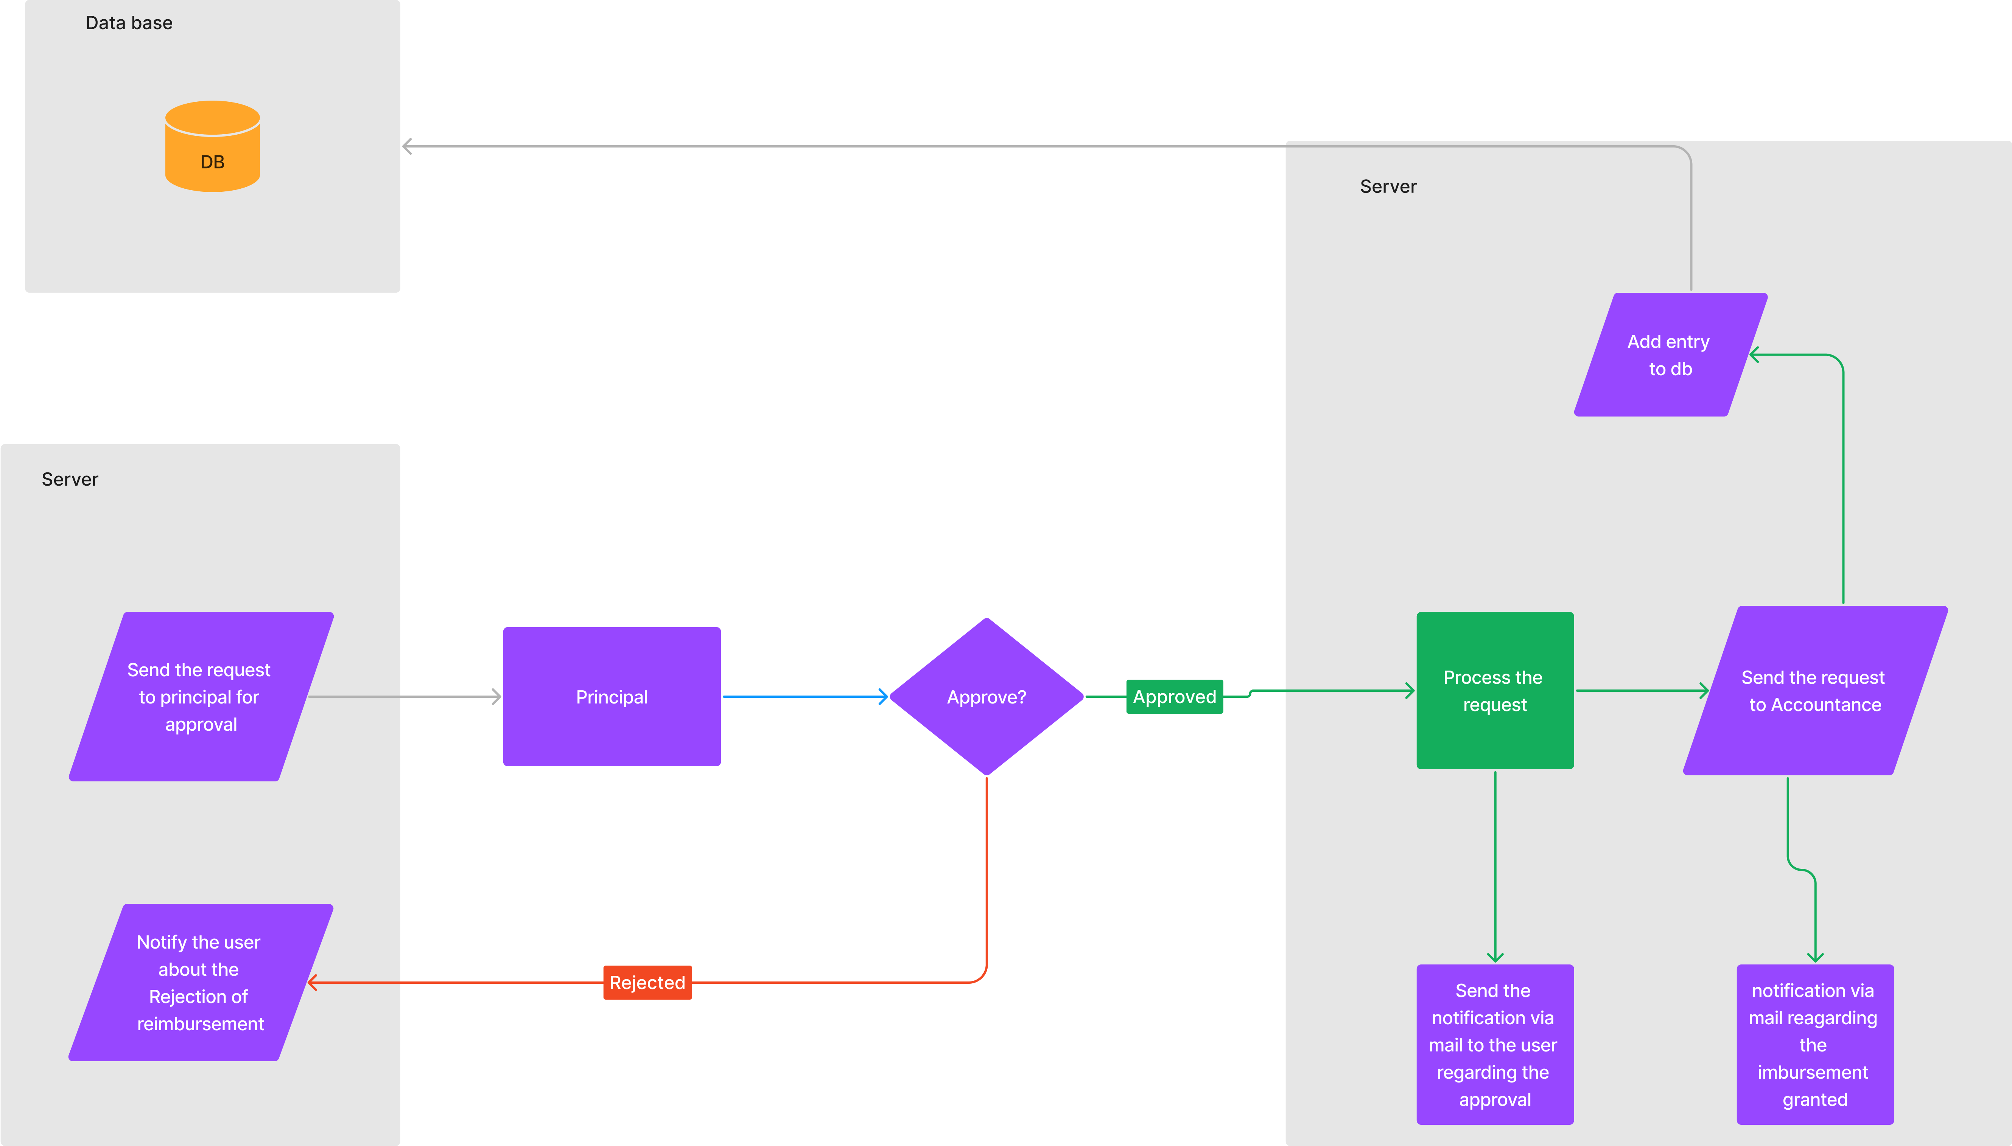

Slide 12





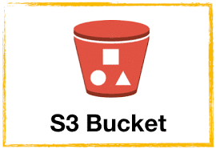
9.Technology Stack
NextJs
ExpressJs
Mongodb
NodeJs
S3 Bucket
Docker

Slide 13
Suggestions in Review-1
A certification upload functionality where a user applying for reimbursement can upload his course completion or examination certification.
A Email must be sent to admin whenever a user apply for reimbursement for alerting that some request have came.

Slide 14
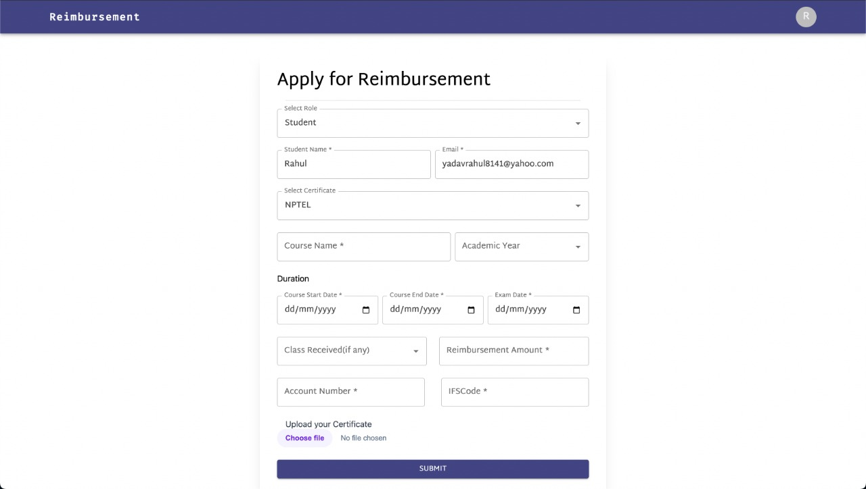
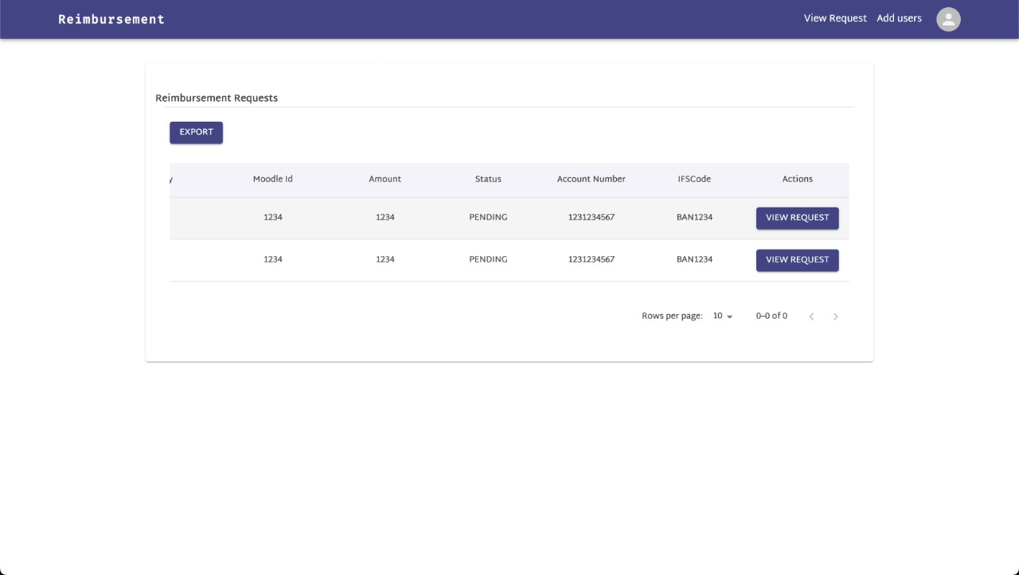
Result and Discussion

Slide 15
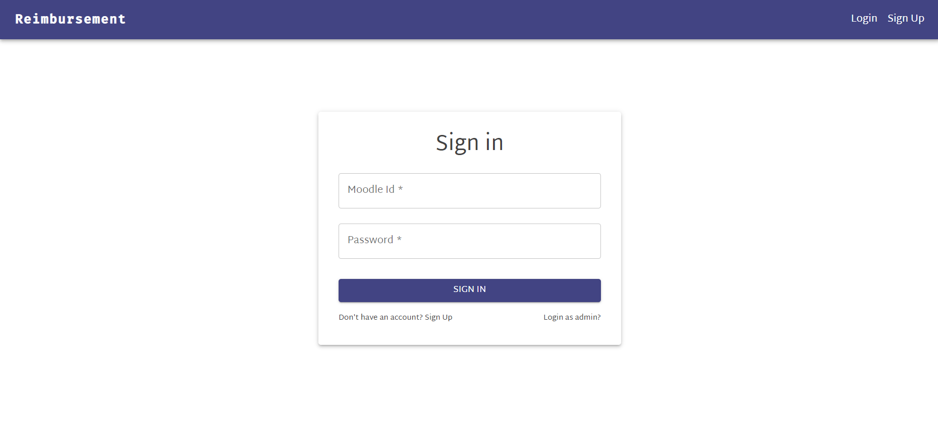
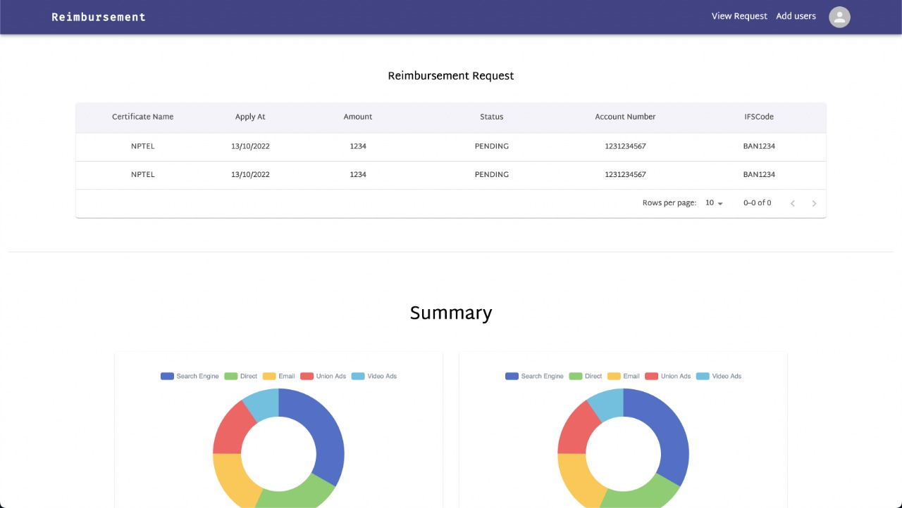
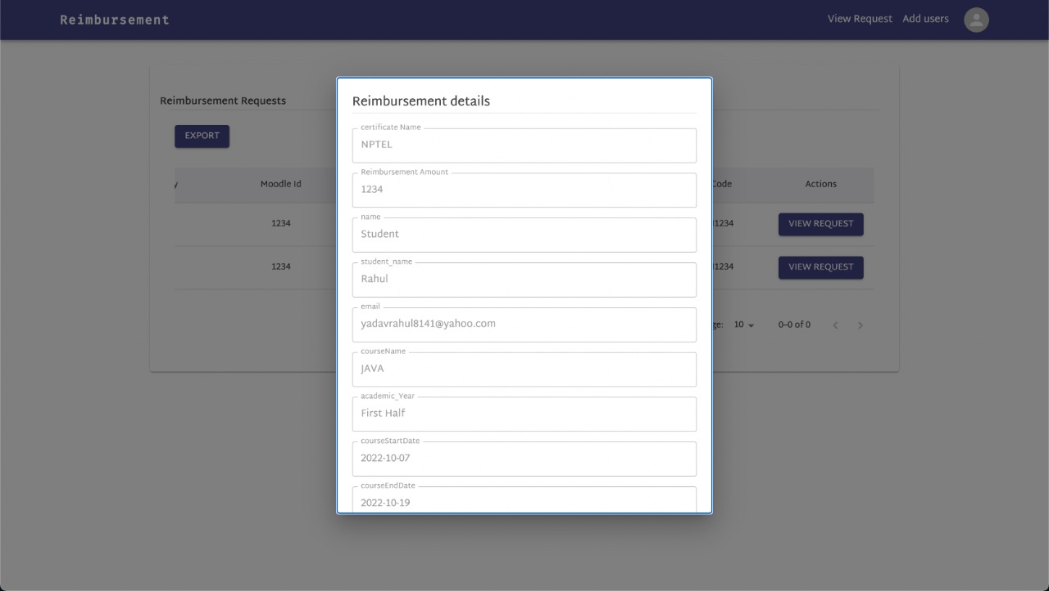
Result and Discussion

Slide 16
Conclusion and Future Scope
To conclude, the reimbursement portal helps the organization or institution maintain records and current requests for reimbursement.
It also helps the institute to approve the pending requests
It reduces manual paperwork.
The Future Scope of this project is to add a receptionist to handle the payment for the approved reimbursement request.

Slide 17
Thank You...!!

